Slide 1

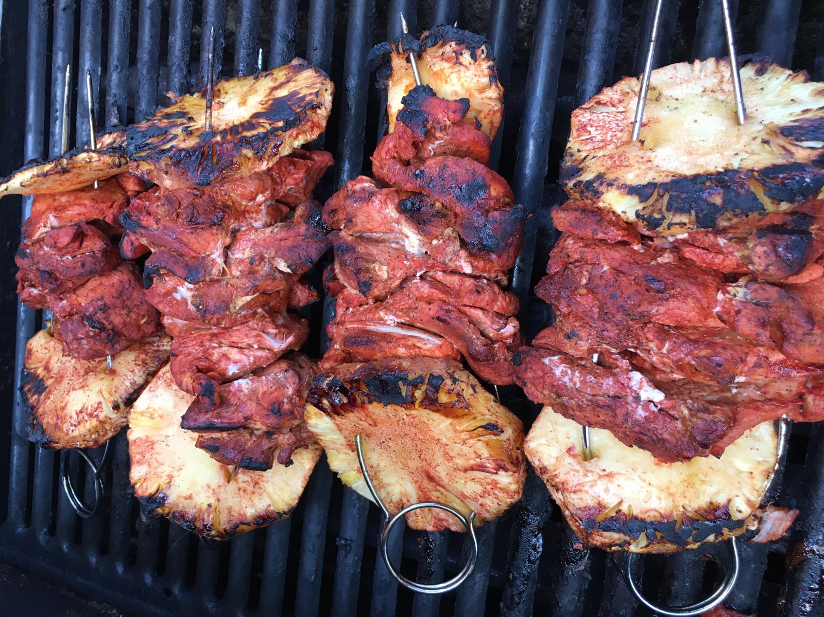




Cooking for Luv Taste of Home
Inspiration
Recipes
Cooking Tips
Shop for your kitchen
Trompo Meat for tacos

Slide 2
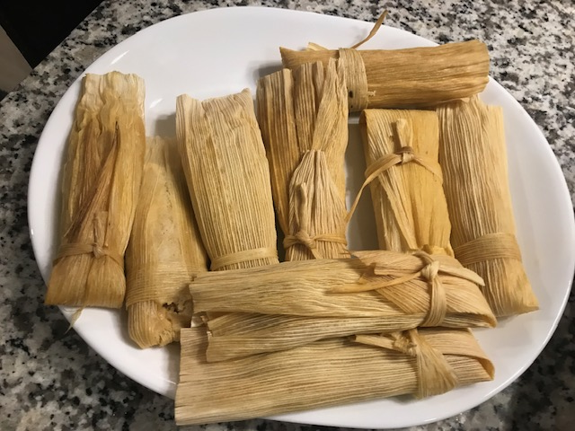

Inspiration
Cooking is an art. Is a language to communicate with people. Is a powerful glue that keep families together. Is a way to celebrate your ethnicity.
Food can defy time travel, one bite can take you back in time to your childhood, as well as transport to other places without traveling.
By cooking the family dishes, those flavors that you grew up with, you are recreating that experience to others, sharing that family favorite dish. The inspiration for cooking are all the cooks before you that took a risk by creating a dish to be shared, a moment to celebrate, and a dish to be remember by.
Mexican Tamales

Slide 3
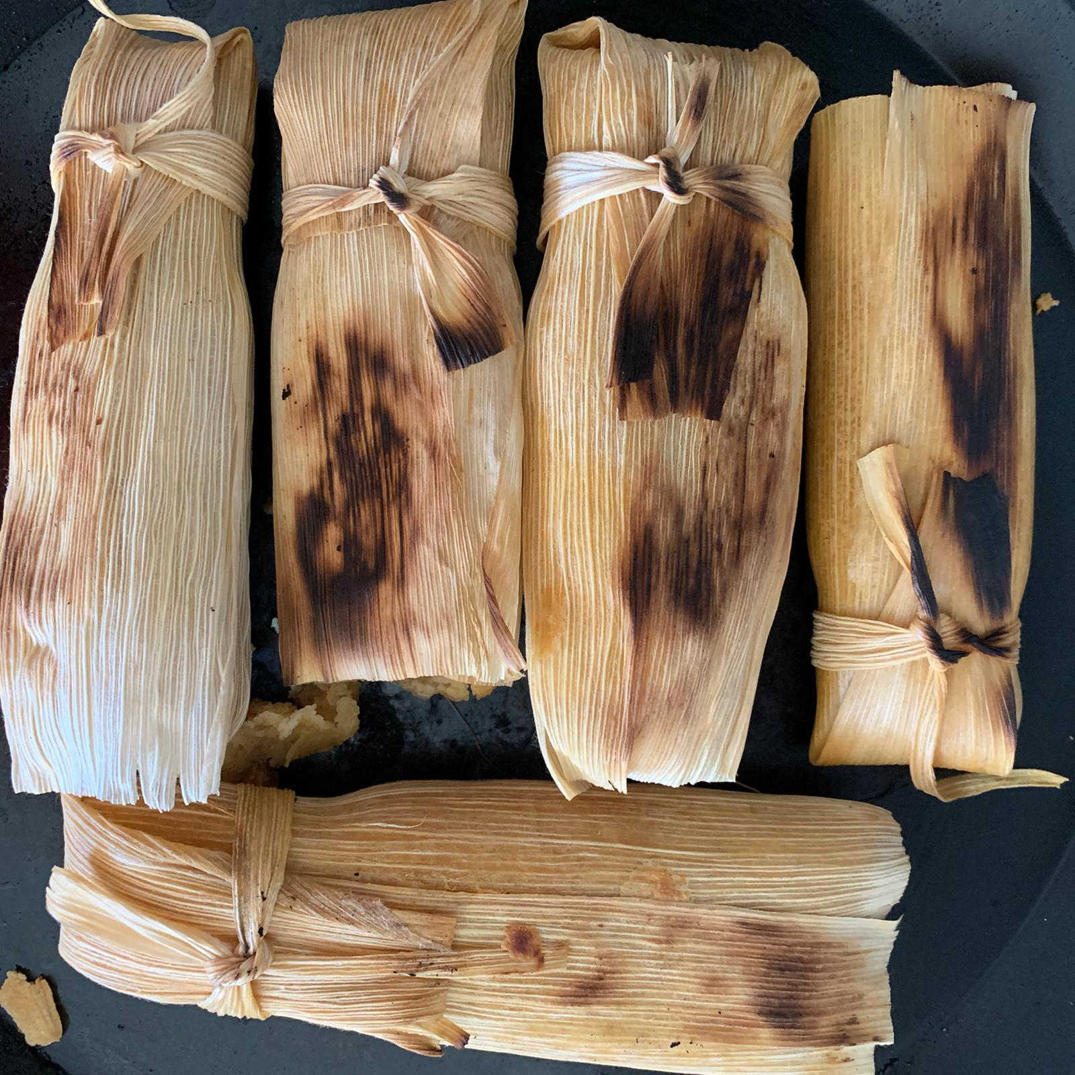
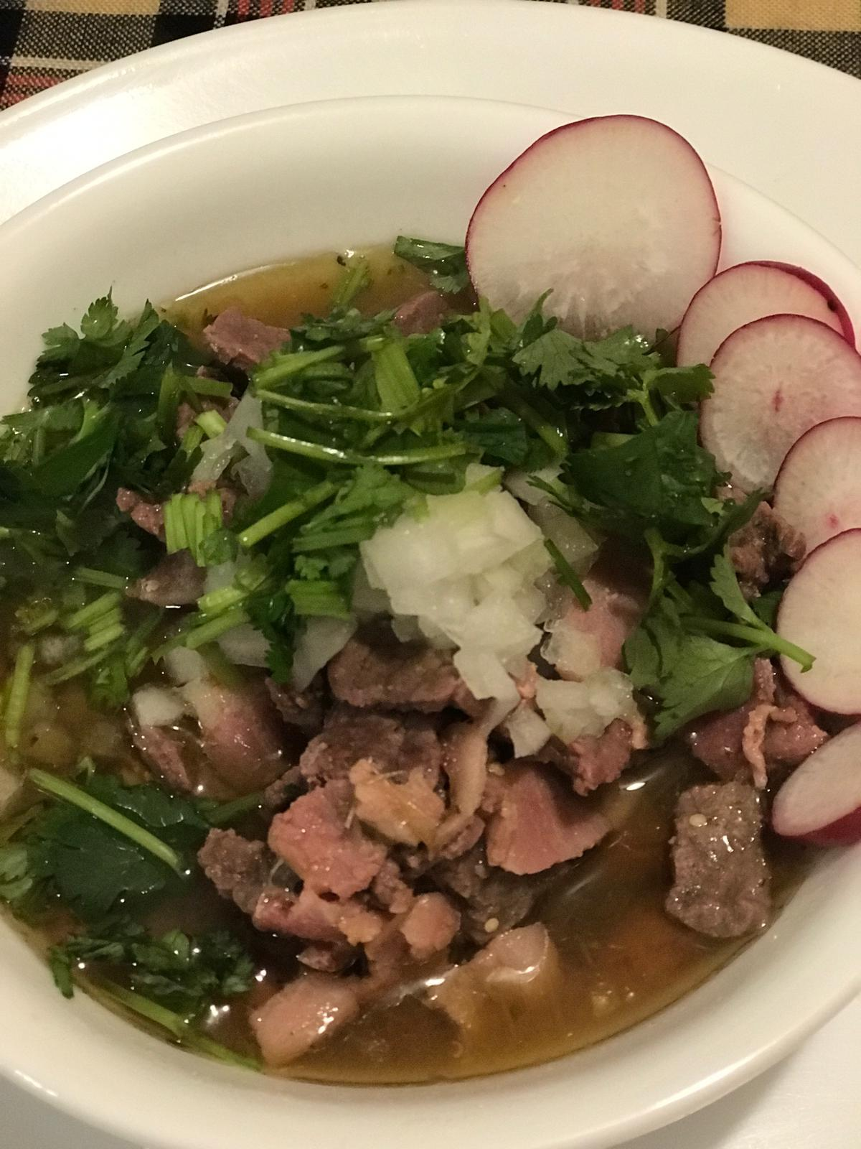
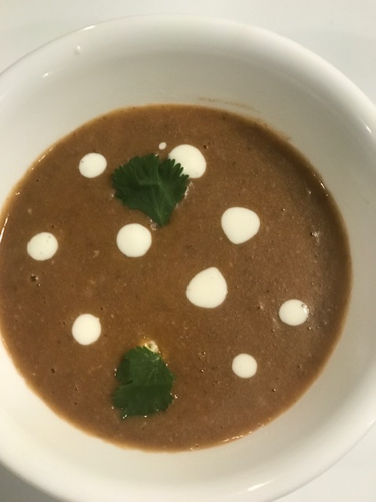
Recipes
Bean Soup
Mexican Tamales
Carne en su jugo

Slide 4
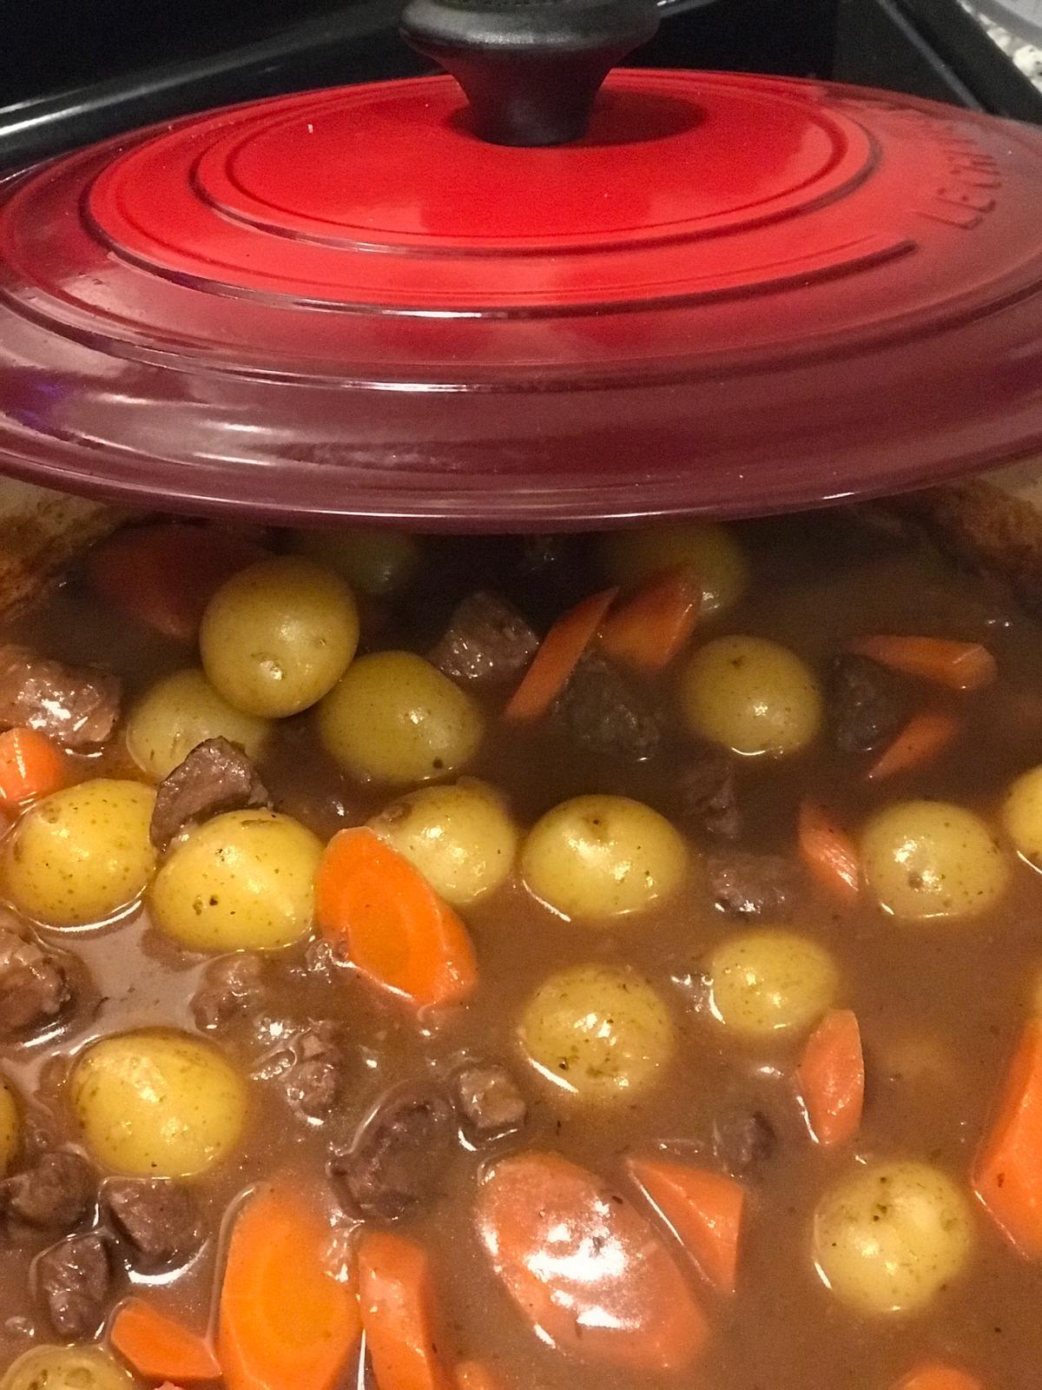
Cooking Tips
Conversion Fahrentheit
To Celsius
Make sure your work area is well lit
Replace your kitchen sponge often
To avoid your cutting board slipping as you chop, put a damp paper or kitchen towel under your cutting board.
Get your knives professionally sharpened once a year to revive those knives. Your chopping will get faster, more precise
Cool your food before putting it in the fridge or freezer so your refrigerator works efficiently and preserves the food longer.
Write a note in your recipes and cookbooks after preparing that dish and you’ll not forget the adaptations or modifications you made to improve it.

Slide 5





Shop for your kitchen

